Slide 1
TacTalk
Voice Recognition Analysis System

Slide 2
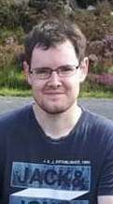
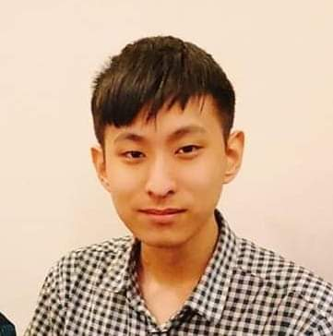
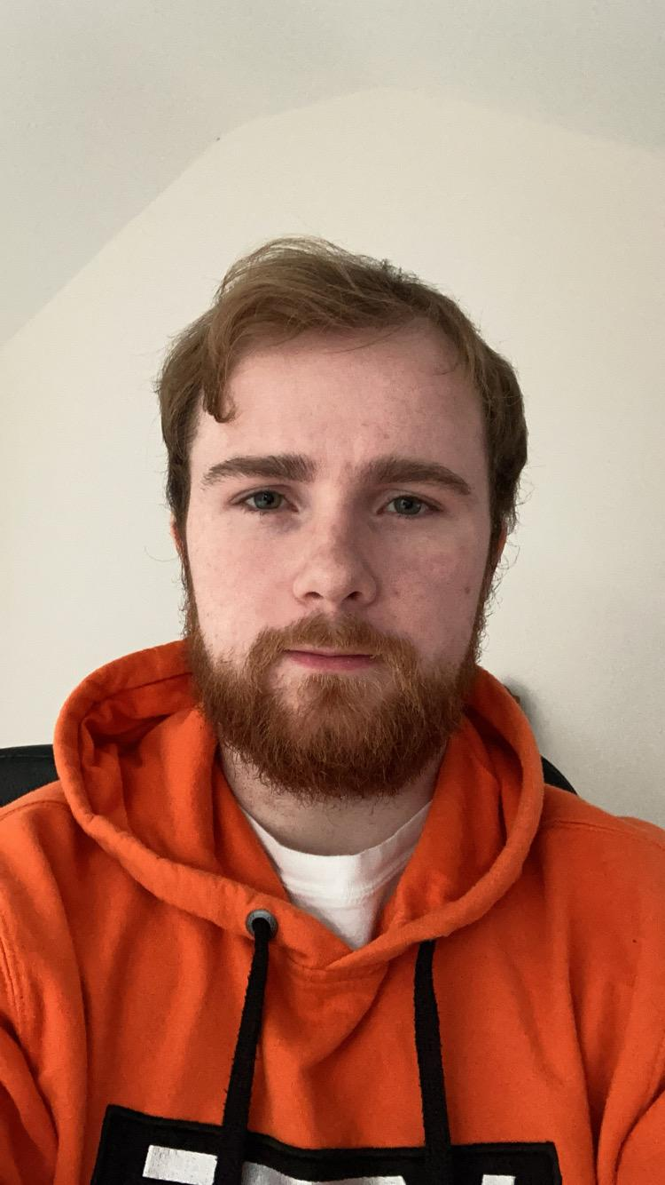
Team Rojak
Francis
Thomas
Timothy
Josh
Shikui
Team Lead
Version control
External Coordinator
Lead app developer
Back end developer
Scrum master
Lead back end developer
Network developer
Lead front end developer
UI designer
Front end developer
Software tester

Slide 3
External collaboration
Kevin McDaid – Lecturer at Dundalk Institute of Technology
Down GAA
Derry GAA
Southern Regional Technical College of Newry
Local clubs

Slide 4
App Idea
Using voice recognition technology to record real-time Gaelic football match data analysis.
Collect and store the formatted speech-to-text data automatically.
Display the match statistics on a web application visually for the manager to view the statistics after the match.

Slide 5
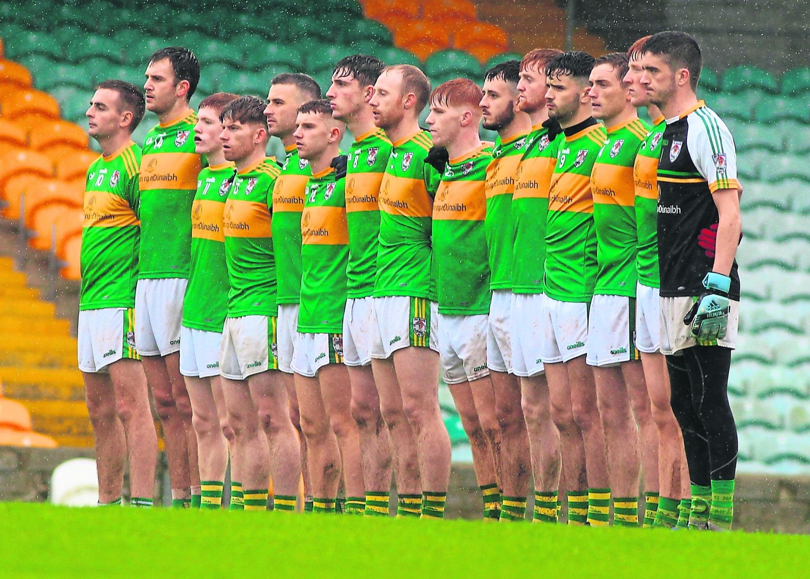
Who is TacTalk aimed at?
Football clubs either at the county level or local clubs who are interested in collecting match statistics and analysing team performance in a quick and automatic manner.
Teams that don’t have a large budget to spend on a tactical analysis system.

Slide 6
What needs does TacTalk meet?
Tactical analysis is typically gathered manually.
Painstakingly gathering data by viewing the recording after the match or sometimes by using pen and paper to write down in-game statistics.
Long and expensive process.
Cost a team a lot of time and money to collect and analysis the statistics.

Slide 7
What needs does TacTalk meet?
TacTalk can make this process automatic.
Save a lot of time and money.
Focus more time analysing the statistics collected.
Doesn’t require any expensive equipment.
Workload is heavily reduced.

Slide 8
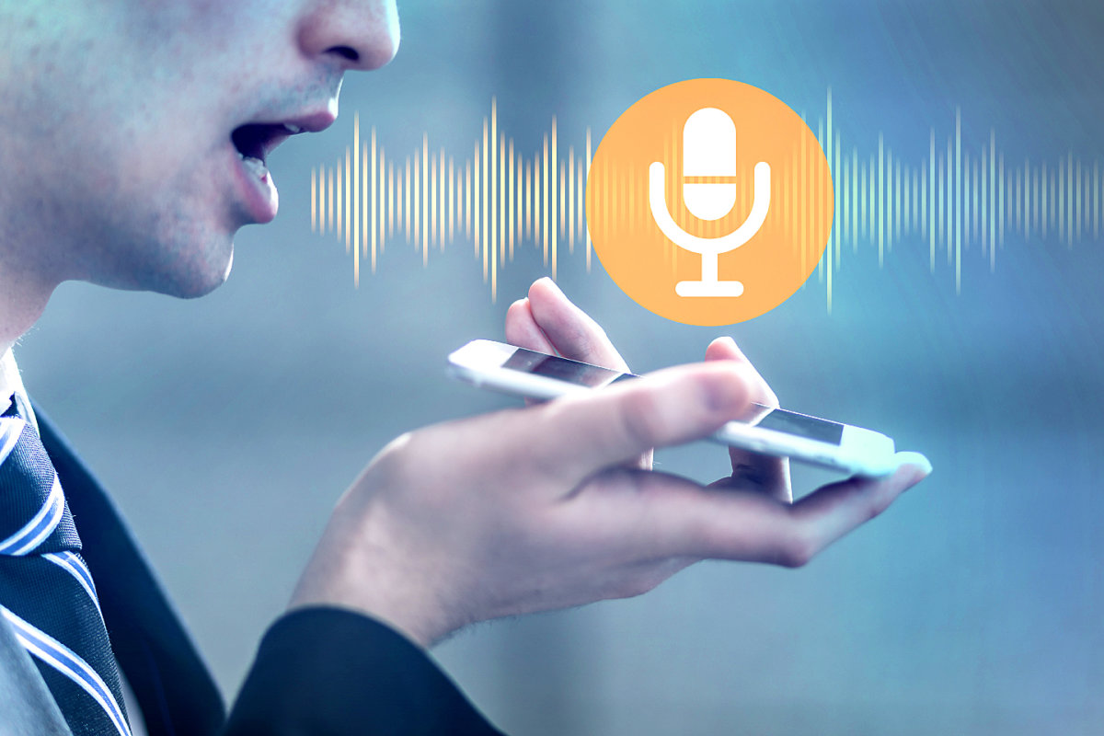
How does TacTalk work?
A match analyst on the side-line uses the voice recognition application to record verbally in-game activities such as goals, shots, missed chances etc.
The analyst would use a vocabulary of key words to mark events that are happening during the match.
The app will send the speech input file to the server to be converted into a text format suitable for the database.

Slide 9
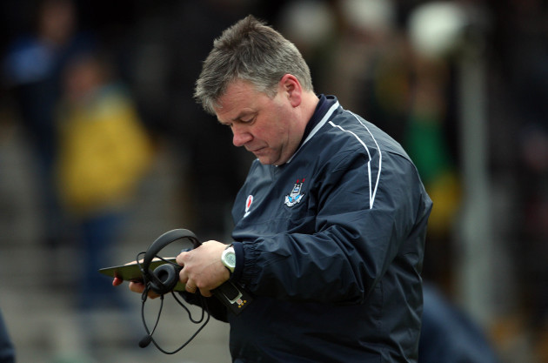
How does TacTalk work?
Manage the team before the match giving each player a number and position.
View half-time match statistics.
Display the full match statistics on a web application for the manager to further analyse the game.

Slide 10
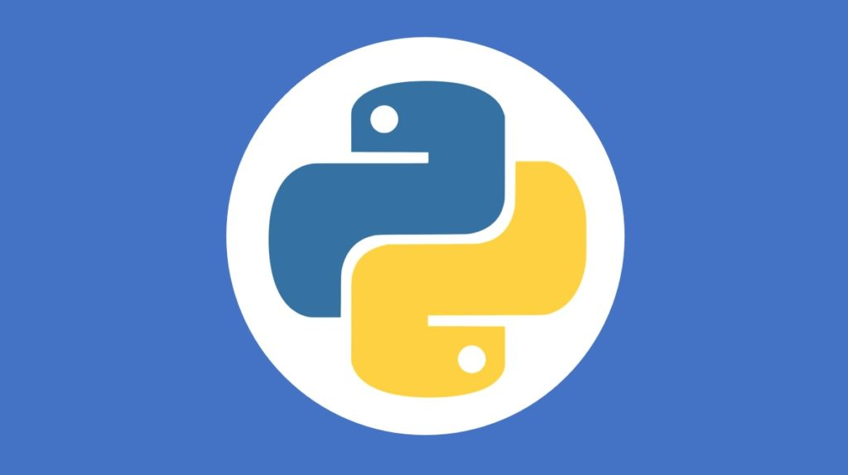
How does TacTalk work? Potential technologies

Slide 11
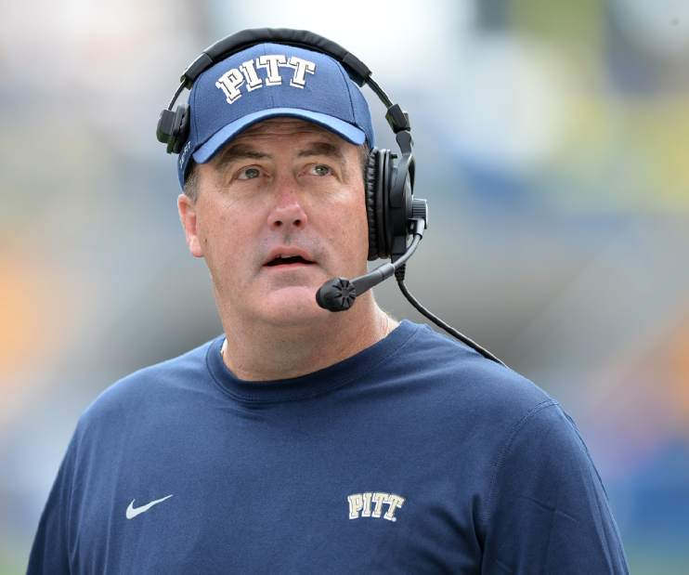
Use case 1
Name: Steven McDonald
Role: Tactical Analyst
Record the live match statistics continuously.
Process keys work efficiently.
Display to the manager at half-time the match statistics.
Analyse the statistics after the match.
Organise the team before the match and set up the match.

Slide 12
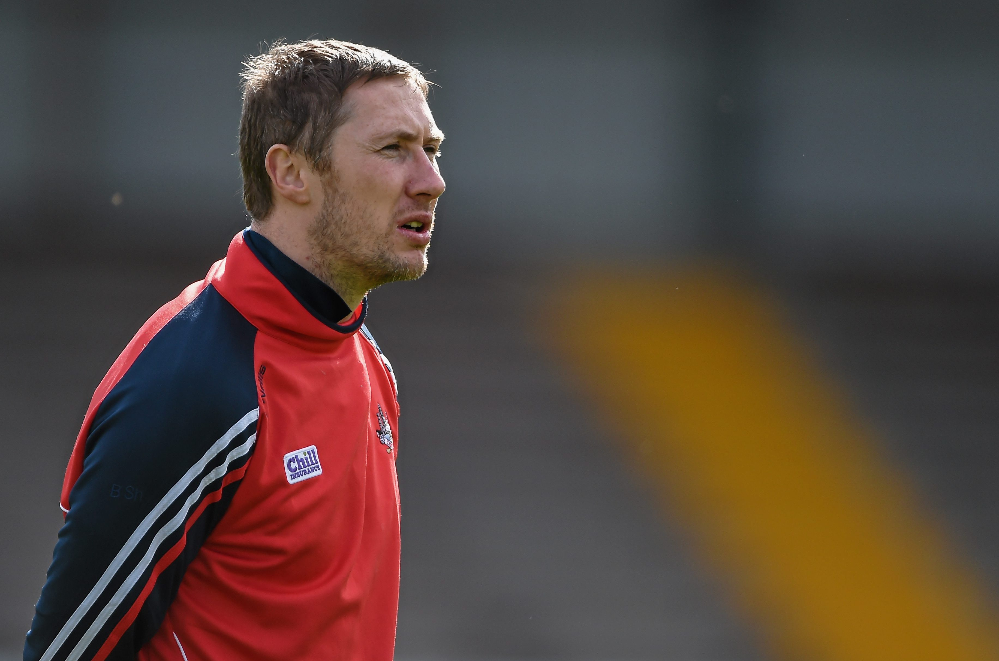
Use case 2
Name: Patrick Doyle
Role: Manager
Organise the team before the match.
View at half-time the match statistics.
Analyse the statistics after the match.
Examine previous match statistics.
Discover team strengths & weaknesses.

Slide 13
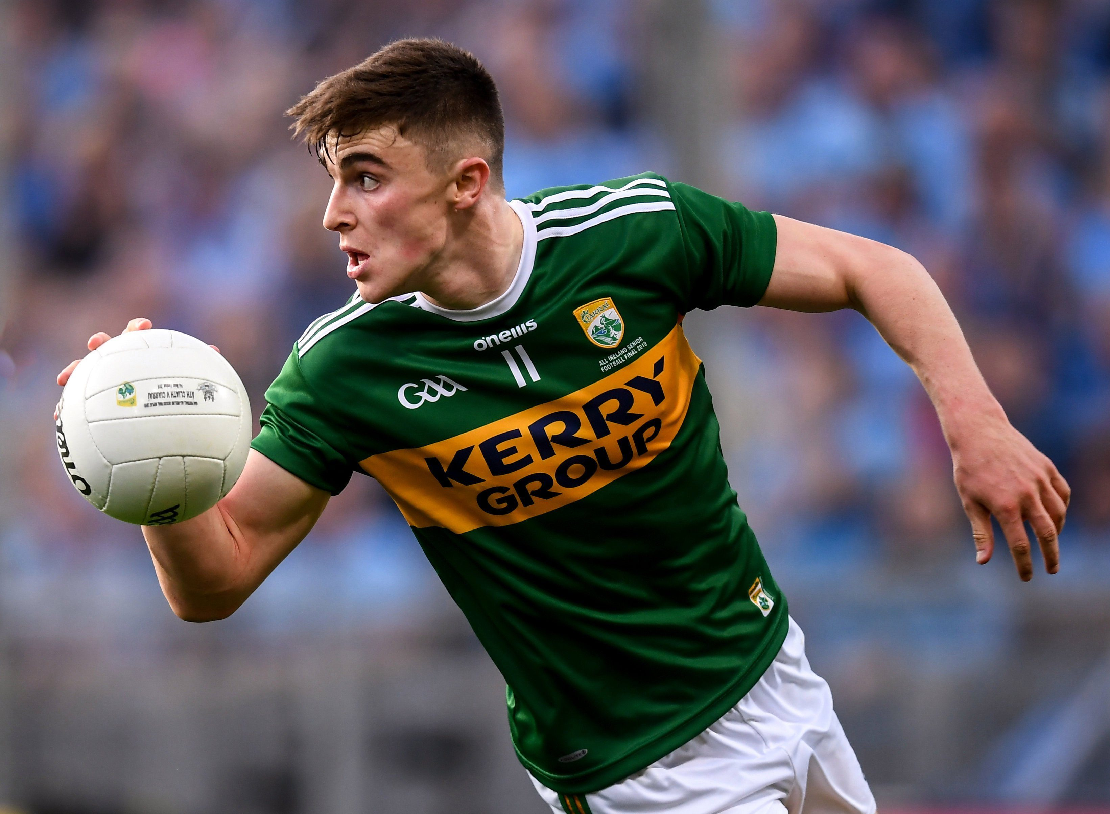
Use case 3
Name: Keith Boyle
Role: Player
View his personal match statistics after the game.
Receive feedback on his performance.
Discover areas in which he could improve.

Slide 14
Mobile UI design prototype

Slide 15
Thank you for listening!

