Slide 1
TacTalk
Tactical Voice Recognition Analysis

Slide 2
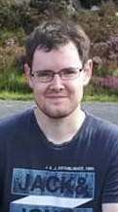
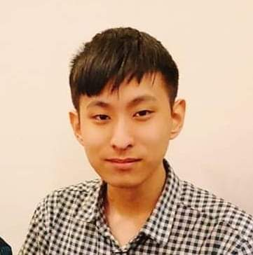
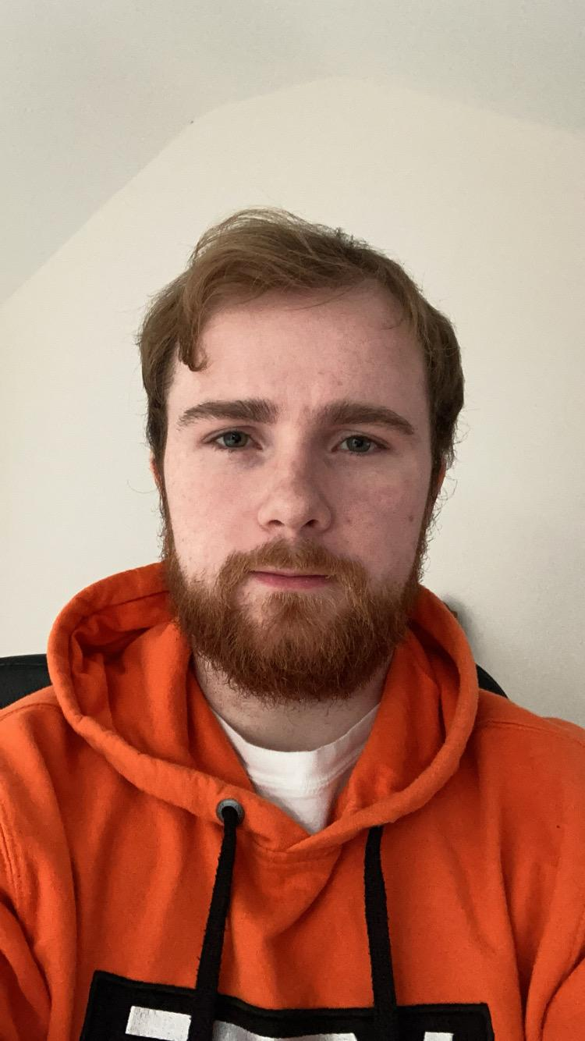
Team Rojak
TacTalk
Francis Quinn
Thomas McKeown
Timothy Nguoi
Josh Nevin
Shikui Wang
Team Lead
Version control
External Coordinator
Cloud developer
App developer
Back end developer
Scrum master
Lead back end developer
Network developer
Database manager
Lead front end developer
UI designer
Front end developer
Software tester

Slide 3
External collaboration
TacTalk
Dr Kevin McDaid
Lecturer at Dundalk Institute of Technology
Down GAA
Derry GAA
Southern Regional Technical College of Newry
Local clubs

Slide 4
Project Overview
TacTalk
Collect real-time match statistics.
Automatic processing statistics.
View up-to-date statistics during match.

Slide 5
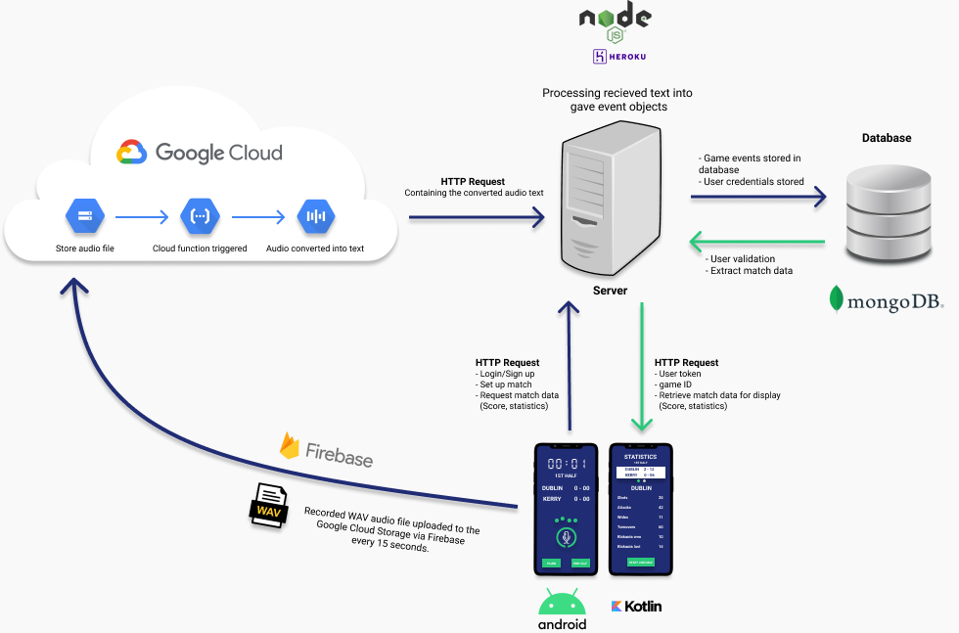
Project Flow Diagram
TacTalk

Slide 6
T-CA3 Application Release
TacTalk
Display Statistics.
Testing.
Improve Command Parser.
Create Match & Manage Team page.
Authentication.

Slide 7
Release 2 Scrumwise
TacTalk
Completed release 2 in 3 sprints
Completed with 82 points

Slide 8
T-CA4 Release
TacTalk
Error Handling.
Live Statistics.
Function Generated Statistics.
Live app user testing.
App Improvements.

Slide 9
User Evaluation COVID-19
TacTalk
Online user testing.
Vocabulary Training Documentation.
Vocabulary Quiz.
Annotating a match. (5 – 35 minutes).
Coach & Analyst Interviews.

Slide 10
User Evaluation Results
TacTalk
Play/Know Gaelic Football |  | Don’t play/know Gaelic Football
High quiz score | Quiz | Low quiz score
Less reading time | Documentation | More reading time
Understood vocab & structure | Vocabulary | Struggled to understand and use vocab the structure.
Easy and enjoyable | Fatigue | Tiresome
More detailed results can be found on the Team Mahara Page.

Slide 11
LIVE DEMONSTRATION

Slide 12
THANKS FOR LISTENING
Q&A

