Slide 1
TacTalk
Tactical Voice Recognition Analysis

Slide 2
Team Rojak
Francis Quinn
Thomas McKeown
Timothy Nguoi
Josh Nevin
Shikui Wang
Team Lead
Version control
External Coordinator
Cloud developer
App developer
Back end developer
Scrum master
Lead back end developer
Network developer
Database manager
Lead front end developer
UI designer
Front end developer
Software tester

Slide 3
External collaboration
Kevin McDaid – Lecturer at Dundalk Institute of Technology
Down GAA
Derry GAA
Southern Regional Technical College of Newry
Local clubs

Slide 4
Project Overview
TacTalk is a tactical voice recognition analysis application that can record and collect real-time match statistics.
The match statistics are processed automatically while the match is in progress.
Statistics can be viewed at half time and full time or any time via the web application.

Slide 5
Project Evaluation COVID-19
Due to the COVID-19 restrictions we had to adapt how to evaluate our project with end-users.
Watching a pre-recorded match remotely while using the app.
Receive feedback over video call (Questionnaire, Q&A)

Slide 6
Release 1 Overview
Working mobile application (Login/register, UI, navigation).
Recording audio and sending audio to the Google Cloud.
Speech-to-Text recognition.
Storing converted text into gameEvent objects.
Displaying gameEvent statistics gathered (score, shots etc.).

Slide 7
Release 1 Scrum
Completed release 1 in 8 sprints
Completed in 165 points
Overall success – App Functional

Slide 8
T-CA3 release goals
Finish necessary mobile functionality.
Complete outstanding API calls, displaying the collected statistics accurately.
TacTalk web application.
Trial the mobile application.

Slide 9
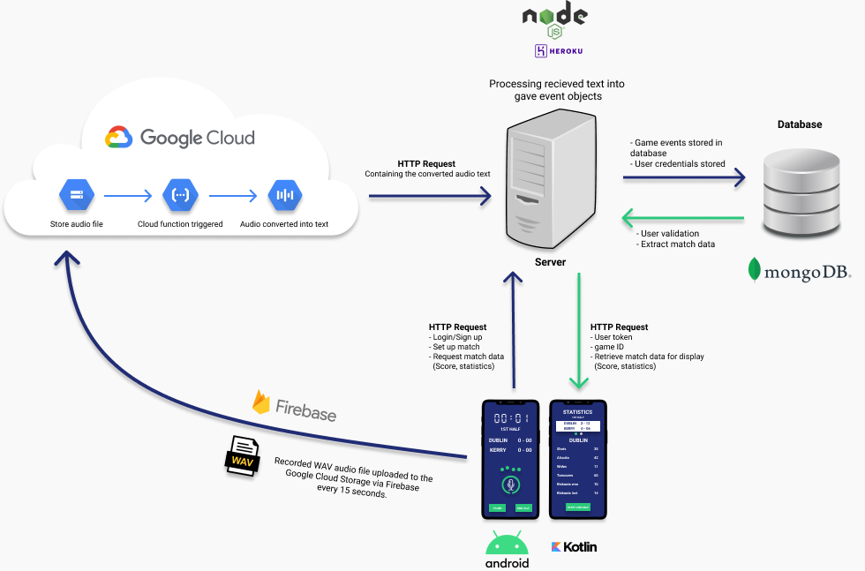
Project Flow Diagram

Slide 10
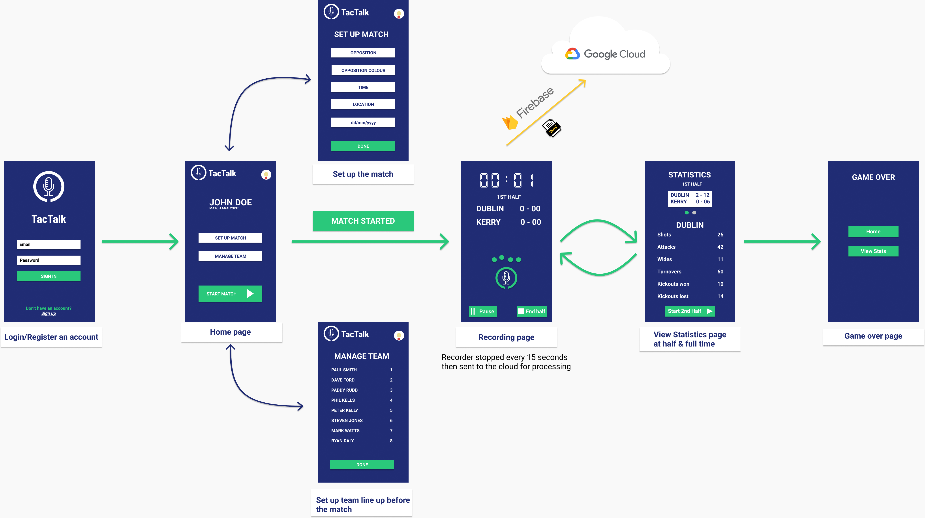
Mobile App Flow Diagram

Slide 11
Google Cloud Flow Diagram

Slide 12
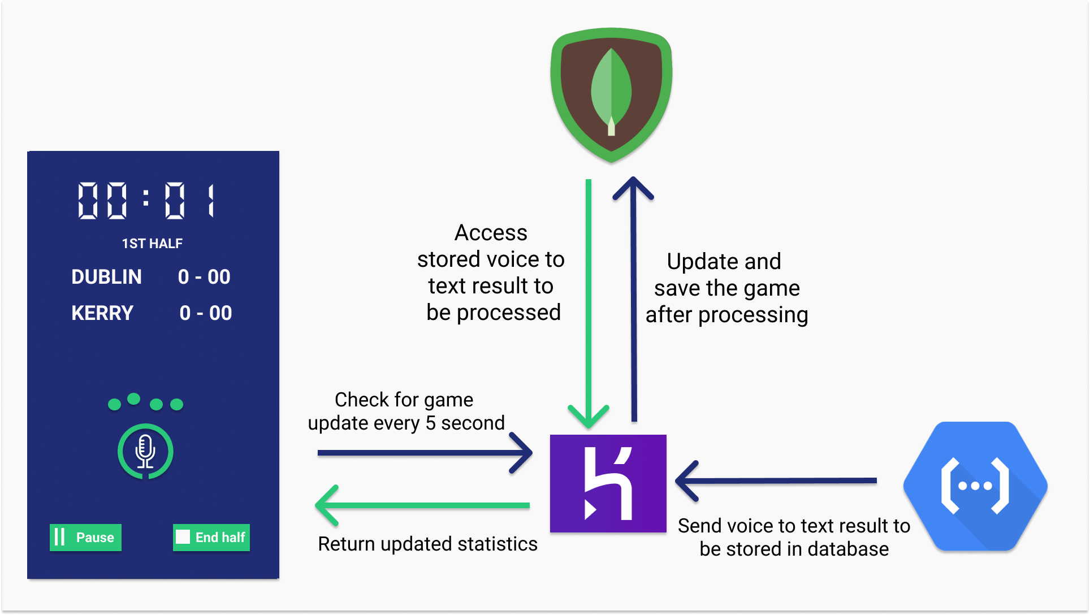
Server Flow Diagram

Slide 13
Parsing Engine Flow Diagram

Slide 14
Event Structure Table
Event Data | Description
Event_type_id | Numeric representation of the event type, I.E., kick pass = 8
Event_position_id | Numeric representation of the position where the event occurred, I.E., Mid-Left = 4
Player_id | the player number of the player who performed the event
Team_id | The team id of the team who performed the event
Outcome_id | Numeric representation of the outcome of the event, I.E., scored a goal = 7
Outcome_team_id | The team id of the team with the outcome, I.E., the team that scored the goal
Outcome_player_id | the player number of the player with the outcome, I.E., the player who scored the goal
time | The timestamp in seconds when this event occurred in the match

Slide 15
Game Event Vocabulary
eventTypeID
eventPositionID
outcomeID
Kickout
Side-line
Side-line Shot
Free
Free Shot
45
45 Shot
Kick Pass
Shot
Hand Pass
Hand Pass Shot
Mark Kick Pass
Advanced Mark Shot
Advance Mark Kick Pass
Carry Ball
Short Left
Short Centre
Short Right
Mid Left
Mid Centre
Mid Right
Long Left
Long Centre
Long Right
Attack 65
Attack 45
Attack 20
Wide
Sideline
45
Free
Point
Goal
Turnover
Free
Mark
Advanced Mark
Won Throw in (Inferred)
Throw in awarded (Inferred)
Kickout & shot
Location
Shots & points are player marked
e.g. Shot Point Player 14
Events within the game

Slide 16
DEMONSTRATION

Slide 17
THANKS FOR LISTENING
Q&A

